Slide 1




SMART INDIA HACKATHON 2026
TITLE PAGE
  Problem Statement ID –26173
  Problem Statement Title- iTantra -Indian Multilingual TTS & STT Aided Neural Transceiver Radio Access for low bitrate links
  Theme-Smart Automation
  PS Category- Software
  Team ID-147967
  Team Name- StepX

Slide 2
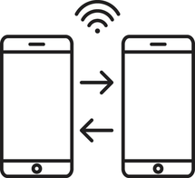










SANWAD
StepX
OUR SOLUTION
  A push-to-talk app for two phones with no internet connection between them.
  One phone listens to speech and turns it into text, sends that text over Wi-Fi or Bluetooth, the other phone reads it aloud.
  It supports 10 Indian languages, so the message stays in the speaker's own language from one end to the other.
  Emergency alerts play at full volume and cannot be silenced.
1
Hold the button and Speak
Push-to-talk, in any of 10 Indian languages.
A
phone
2
The phone writes it down
Speech becomes text the moment you release.
HOW IT WORK
3
The words travel
Bluetooth, Wi-Fi Direct, or a cable into a radio.
HOW IT IS DIFFERENT
  Bhashini, Google, Zello — need the internet
  Bridgefy, Briar, Meshtastic — work offline, but only send text you must read
  FreeDV, Codec2 radios — send voice, but stop at 700 bps and speak no Indian language
  Ours is voice in and voice out, offline, in 10 Indian languages.
4
Other phone
Checked, repeats dropped, sentence rebuilt.
B
phone
5
It speaks out loud
A natural voice, in the language you used.
WHY IT IS DIFFERENT
  Sending your actual voice needs roughly 8,000 to 16,000 bits every second.
  Emergency and satellite links often carry only a few hundred bits per seconds, raw Voice simply doesn't fit.
  One spoken sentence written down is about 118 bytes.
  We squeeze it to 44 and wrap it up to about 100 bytes. That fits almost any link.
If it is an emergency
Full volume, ignores silent mode, cannot be stopped.
6
ALERT
Just speak and listen — nobody ever has to read.
Notes:
2

Slide 3
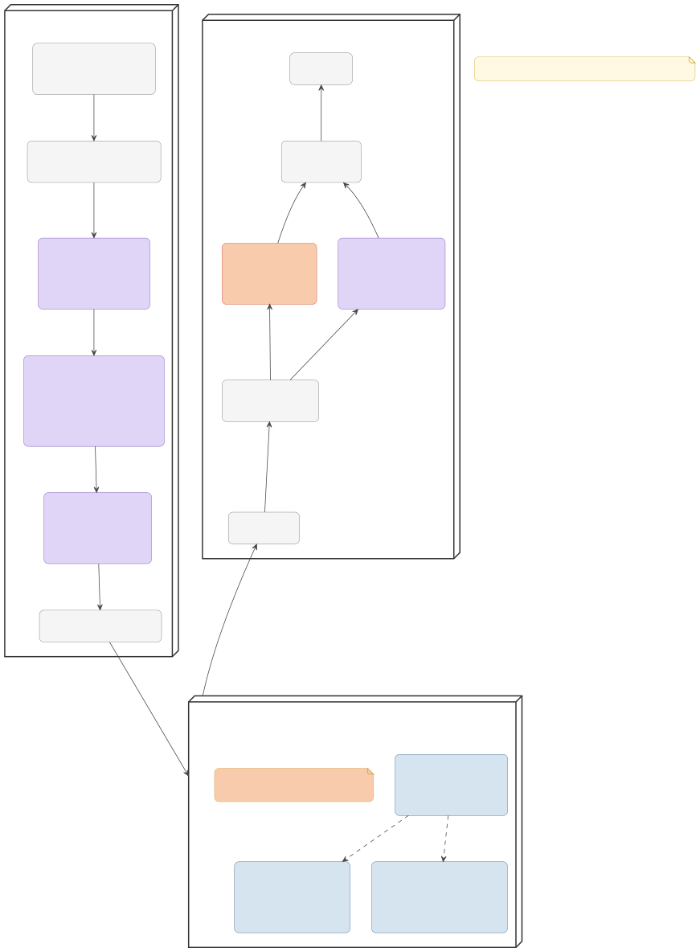
TECHNICAL APPROACH
StepX
PROTOTYPE—
«device» SENDER PHONE
«device» RECEIVER PHONE
«component»
PTT + Foreground Service (Kotlin / Android SDK, voice in, mic live)
«hardware» Speaker
ALERT = AUDIOFOCUS_GAIN_TRANSIENT_EXCLUSIVE + max volume, non-interruptible.
APP
Kotlin • Jetpack Compose • MVVM • Coroutines
plays
«component»
Audio Capture
(Mic + AudioRecord, 16 kHz)
«component» Audio Playback (AudioManager)
LOCALIZATION
UI strings per locale (10 languages) • native-script language picker
frames
PCM, skips TTS [ALERT phrase]
PCM speech [NORMAL]
«model»
«model»
Tiered VAD energy/WebRTC gate → Silero-VAD (ONNX), continuous, low CPU
« alert» «component»
«model»
«model»
TTS: Indic-TTS INT8 (FastPitch + HiFi-GAN) ONNX, lazy-load 1
run: NNAPI/XNNPACK
SPEECH IN (VAD + STT)
Tiered VAD: energy/WebRTC gate → Silero-VAD • IndicConformer INT8 (sherpa-onnx) • Whisper.cpp fallback
Static Alert Audio (pre-rendered PCM, skips TTS)
on pause/stop
priority
priority
«model»
«model»
STT: IndicConformer INT8 (sherpa-onnx)
1 of 10 languages resident run: NNAPI/XNNPACK
(hi gu mr kn ml ta te or bn en) Whisper.cpp fallback
SPEECH OUT (TTS)
Indic-TTS INT8 (FastPitch + HiFi-GAN) • pre-rendered alert bank • espeak-ng fallback
«component» Priority Manager (NORMAL vs ALERT)
Tecnologies to be Used
words + sentence
priority
ML RUNTIME
Wi-Fi Direct / local Wi-Fi • Bluetooth (BLE + RFCCOMM)
«model»
«model»
Sentence Frame Protobuf {lang, text, priority, time}
TEXT ONLY, NO AUDIO
«component» JSON Decoder
COMMS
BLE (default) • RFCOMM (embedded/gateway peers) • Wi-Fi Direct (opportunistic fast path)
text payload
«component»
Transport Manager (send)
JSON text
text payload
TRANSPORT
UDP for chat • TCP for guaranteed alerts
«channel»
TEXT LINK (JSON/Protobuf only — audio never crosses)
Protobuf + AES-GCM on every frame, plus Ed25519 signing on
ALERT messages only.
«channel»
«component»
BLE: Advertiser + GATT (Discovery / idle pairing — DEFAULT)
DATA SECURITY
Protobuf frames + AES-GCM • Ed25519 signing (alert path only) • Room/SQLite
discover
discover
«channel»
«component»
Bluetooth Classic Adapter + Socket
(For embedded/gateway peers: ESP32, HC-05)
«channel»
«component»
Wi-Fi Direct
(WifiP2pManager) Opportunistic fast path — falls back to BLE if setup fails
AUDIO TUNING
AudioRecord/AudioTrack • INT8/FP16 • AEC (full-duplex) • latency logger
Notes:
3

Slide 4
FEASIBILITY AND VIABILITY
StepX
TECHNICAL
ECONOMIC
OPERATIONAL
Strategy pillar | Application to sanwad
Target End-Users | NDRF (Disaster Response), State Maritime Boards (Fishermen), and rural frontline workers operating beyond cell coverage.
Distribution Channel | B2G (Business-to-Government) handoff. The app serves as a Digital Public Infrastructure (DPI) tool distributed via government portals or pre-installed on state-subsidized hardware.
Financial viability | Hyper-sustainable because of the ₹0 recurring operational cost. The government pays zero cloud or cellular transmission fees since all computing is done on the edge.
Maintanence Model | Open-source community stewardship, with language-model updates tracked against upstream AI4Bharat / sherpa-onnx releases.
  Every part open-source & verified.
  INT-8 quantized models (42–188 MB/lang) fit within 2 GB RAM budget.
  Utterance-level non-streaming decode prevents hallucination & lowers CPU.
  ₹0 infrastructure — no towers, servers, or cellular data.
  Low standby footprint: Silero-VAD/TFLite gate draws <15% idle CPU.
  Targets ₹8–10k · 3-4 GB RAM phones.
  Voice-first UX for illiterate users; 1-tap zero-pairing walkie-talkieders.
  End-to-end voice relay in
seconds over peer-to-peer
WIFI/Bluetooth
  Non-interruptible alerts bypass system.
Potential challenges and risks
Strategies for overcoming these challenges
IndicConformer has no ready Odia export
Convert/distill from the AI4Bharat checkpoint before demo day; disclose the gap openly if not ready.
OEM ROMs kill mic & alarm playback
Foreground service + alarm stream + whitelist + ROM test script.
Phone radios reach only ~100 m
Mesh relay + LoRa bridge + SMS + store-and-forward.
Noisy venues · ta/ml/te WER fairness
Noise-robust VAD + published char-level WER protocol.
36-hour offline finale build
Vendored deps; pre-paired spare phones; rehearsed demo kit.
Bundling all 10 languages = ~1.5 GB bloat
On-demand packs — install only your preferred languages.
Notes:
4

Slide 5

IMPACT AND BENEFITS
StepX
Potential impact
Benifits
Strategy pillar | Application to sanwad
SOCIAL | -Language Inclusivity: Full coverage for 9 Indic languages + Indian English, breaking linguistic barriers in diverse rescue zones. Life-Safety Alert Policy: Emergency frames bypass mute/DND via USAGE_ALARM at maximum volume to wake operators even from locked screens.
ECONOMIC | ₹0 Infrastructure & Transmission: Zero cellular airtime, zero cloud compute, and zero recurring server costs. Runs on Budget Hardware: Fully optimized via int8 quantization for ultra-budget ₹8,000–₹10,000 Android phones (Cortex-A53/A55, 4 GB RAM).
ENVIRONMENT · STRATEGIC | Runs on Budget Hardware: Fully optimized via int8 quantization for ultra-budget ₹8,000–₹10,000 Android phones (Cortex-A53/A55, 2 GB RAM). Low Battery Footprint: Silero-VAD gate draws <15% single-core CPU during idle listening, giving 8+ hours of armed standby.
• Fishermen & coastal communities — SOS without towers, in their own language
• Disaster relief — village-wide alerts when networks are down
• Elderly & low-literacy users — nothing to read or type, ever
• Disabled users — live transcript for deaf users; voice output for users who can't easily type.
• Remote teams — border posts, expeditions, ISRO low-bitrate operations
50–100× lighter than audio codecs | ≤ 2–3 s mouth-to-ear latency | 10 Indian languages, offline | ₹0 network / infra cost | 8 h+ armed standby battery
Notes:
5

Slide 6
RESEARCH AND REFERENCES
StepX
Capability / Feature | SANWAD (Proposed) | Standard Walkie-Talkie (VHF) | Opus over WebRTC
Required Channel Bitrate | ~0.5 – 1.0 kbps (Text) | Analog (Broadband RF) | 12 – 32 kbps (Compressed)
Network Infrastructure | Zero (Ad-Hoc P2P) | Direct Line-of-Sight | Local Wi-Fi access point required
Cross-language speech | Yes (Local STT & TTS) | No (Raw Audio Only) | No (Raw Audio Only)
Non-Interruptible Max Alert | Yes (USAGE_ALARM Override) | Manual Volume Knob | Subject to Media Volume
Device Power Consumption | Ultra-Low (VAD-gated BLE scan) | High Continuous RF Drain | Moderate
  Whisper, Radford et al., 2022 — https://arxiv.org/abs/2212.04356
  Conformer, Gulati et al., Interspeech 2020 — arxiv.org/abs/2005.08100
  VITS, Kim et al., ICML 2021 — arxiv.org/abs/2106.06103
  IndicConformer (MIT) — github.com/AI4Bharat/IndicConformerASR
  IndicConformer 120M CTC ONNX — huggingface.co/trysem/indicconformer-120m-onnx
  IndicF5 — huggingface.co/ai4bharat/IndicF5
  Silero-VAD — github.com/snakers4/silero-vad
  sherpa-onnx — github.com/k2-fsa/sherpa-onnx
  ONNX Runtime Mobile — onnxruntime.ai/docs/tutorials/mobile
  RFC 4838, Delay-Tolerant Networking — rfc-editor.org/rfc/rfc4838
  ggwave (data-over-sound) — github.com/ggerganov/ggwave
Notes:
6

